Slide 1
MtE Design
By: Angelo Maldonado-Liu, Bhavya Gandheti,
Bhuvan Yadav Nagulla, Sai Bhargav Reddy Gujjula

Slide 2
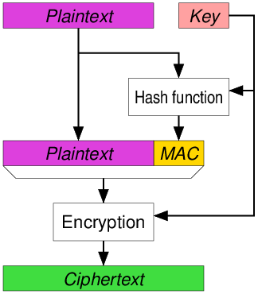
What We Started With
MAC then Encrypt (MtE)
Use a key with the data as input to encryption (wikipedia, 2023)

Slide 3
Our Contribution
Using the description of an MtE design, we tried to design and simulate it.

Slide 4
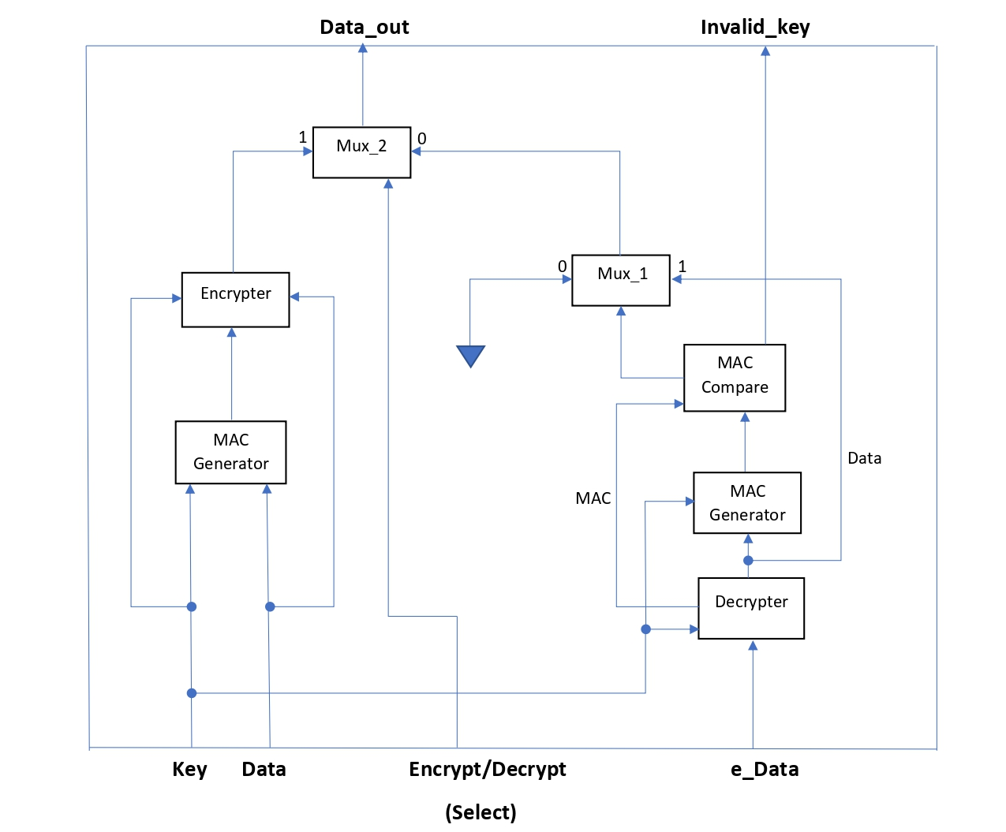
Initial Block Diagram
Input
32 bytes of data
8 bits of key (password)
encrypt/decrypt flag
Output
32 bytes of data output
invalid/valid key flag

Slide 5
Final Design specs
Input
32 bytes of data
32 bytes of key (password)
encrypt/decrypt flag
Output
32 bytes of data output
invalid/valid key flag

Slide 6
Modules
MAC Generator
simple generator that just XORs the data with the key
Encrypter
5 clock cycles to complete
Decrypter
5 clock cycles to complete
MtE
uses mux to determine encrypt or decrypt

Slide 7
Encryption/Decryption Algorithm
Simple algorithm that could be reversed
Encrypt
XOR key and data
rotate left by half of size, so 128
NOT all bits
reverse order of bits, bit 0 becomes bit 255, bit 1 becomes bit 254, etc
rotate right by half of size
Decrypt
rotate left by half of size
reverse bits
NOT all bits
rotate right by half of size
XOR key and data

Slide 8
Verification - encrypt
identify which characters of a string would be problematic for verifying.
Ascii values 0 - 31 are problems for displaying as a string (except TAB and NL, but we excluded them for ease), as well as ascii 127 (DEL)
Next we generate random strings of size 32 excluding those ascii values (to emulate reading from file)
used a class and randomized values of bytes, restricting value to 32-126
make a string of random bytes cast as string
Then we convert the strings to bits to take in as input
used shift and string method getc()
manually test a few cases.
constraint str_len {input_char.size() == 32;}
constraint no_eof { foreach(input_char[i])
input_char[i] inside {[32:126]}; }
foreach(input_char[i])
input_string = {input_string, string'(input_char[i])};
IN = (IN << 8) | str.getc(i);
Thank you Dr. Faust.

Slide 9
Verification - decrypt
Send in encrypted data from last case and check if bits from output of decryption is equal to bits from input to encryption
if(OUT !== IN)
$display("Decrypted wrong.");

Slide 10
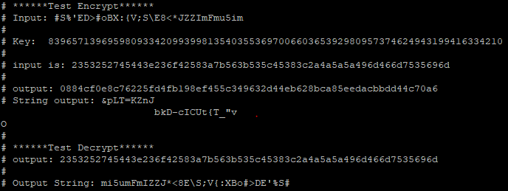
Verification - Options
Added 2 options for verification
Verbose
displays input string, key (as decimal), input in hex, output from encrypter as hex and string, then output of decrypter in hex and as a string with encrypter output as input.
Extensive
changes number of random test cases from 10 to 100,000

Slide 11
Design Difficulties
Converting from string to bits
were able to shift in the ascii values of each character
Making strings of varying lengths work
find string length, and send in substrings of 32 bytes, until substring is less than 32, at which point zero out the bytes until we get 32 total bytes, and send that in.
Figuring out how the MtE system knows it is done
wanted to do an eof detector, but after encryption, could have multiple eof’s
reading from file
were issues when reading from file, but by generating random strings, that emulates getting random strings from a file.

Slide 12
Bugs found
Problematic ascii characters when displaying strings for manual checking (as discussed previously)
The string output of the decrypter is backwards from what was input into the encrypter
There is also a bug where after we run and display the encrypted output, it makes us print the name of the program we are running.

Slide 13
Sources
Wikimedia Foundation. (2023, March 14). Authenticated encryption. Wikipedia. Retrieved March 22, 2023, from https://en.wikipedia.org/wiki/Authenticated_encryption

